Slide 1
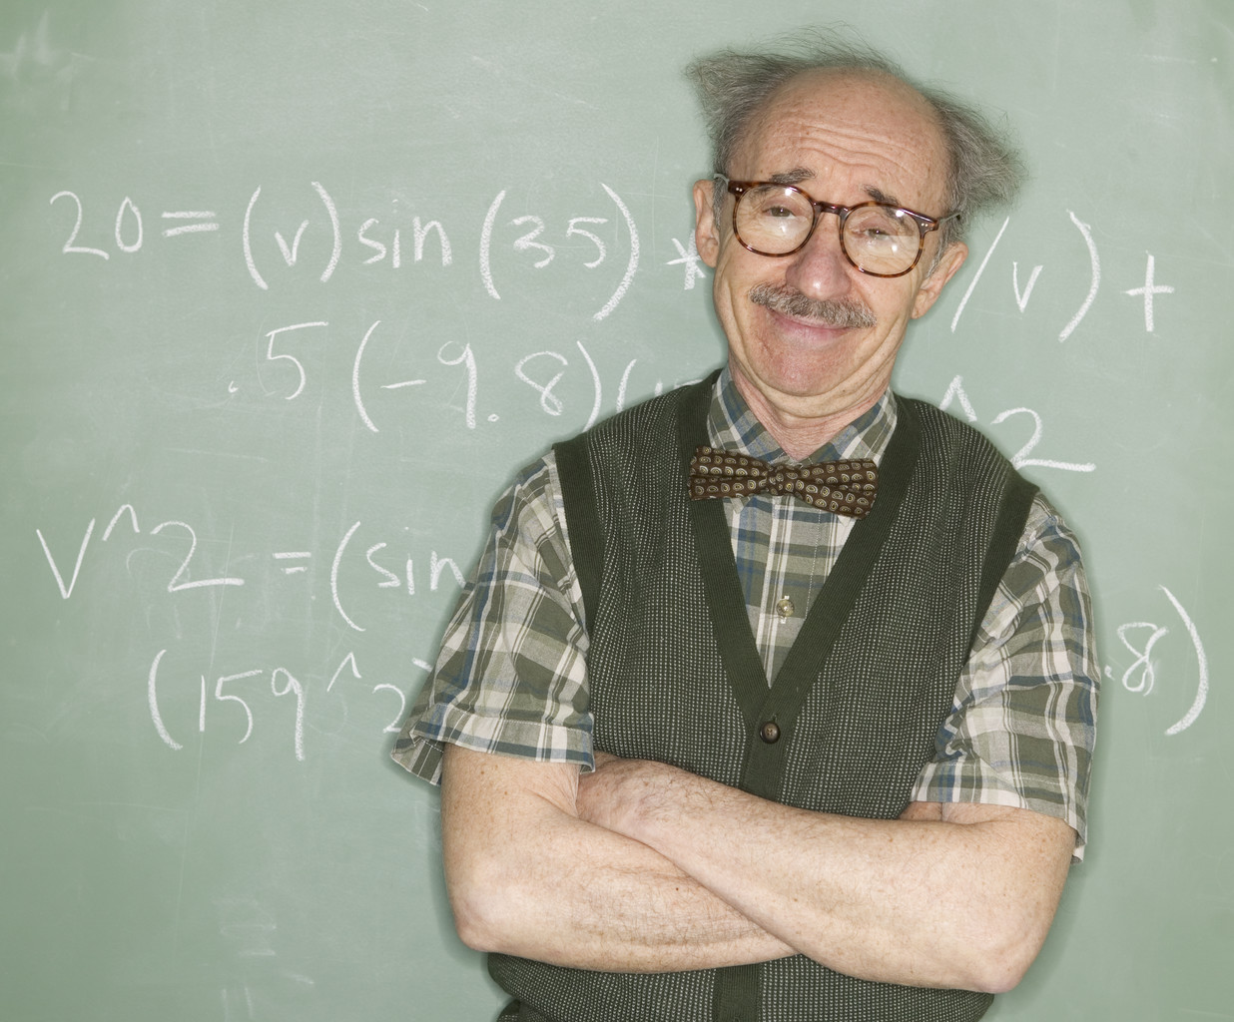
Parallel and Perpendicular Lines
If a line has the equation y=2x+4 can we find a line that is parallel or perpendicular to it?
HAVE YOU NOT GOT OFF THIS SLIDE YET?
COME ON! GET MOVING GUYS!

Slide 2

y=mx+c
Remember the equation of a straight line
m is the gradient and tells us how steep a line is
c tells us where the line crosses the y axis

Slide 3
y=2x+5
Remember the equation of a straight line
This line has a gradient of 2
This line crosses the y axis at 5

Slide 4
y=0.5x-8
Remember the equation of a straight line
This line has a gradient of 0.5
This line crosses the y axis at -8

Slide 5

Parallel Lines
Parallel lines never meet, even if they carried on FOREVER!

Slide 6
y=2x+5
Here are some lines which are parallel to y=2x+5
y=2x + 6
y=2x + 7
y=2x + 16
y=2x + 1
y=2x + 3
y=2x + 12
y=2x - 6
y=2x -2
y=2x
y=2x + 0.2
y=2x + 60
y=2x - 11
y=2x -10

Slide 7
Parallel Lines
Parallel lines never meet, even if they carried on FOREVER!
Parallel lines have the same GRADIENT (m) but different Y INTERCEPTS (C)

Slide 8
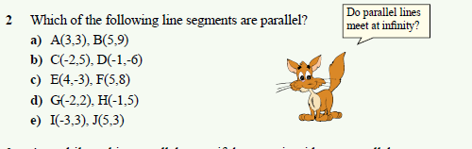

Slide 9
Parallel and Perpendicular
The gradient is a number that tells "how steep" the line is and in which direction. So as you can see, parallel lines have the same gradients.
Perpendicular lines have negative reciprocal gradients.

Slide 10
Perpendicular Lines
Perpendicular lines meet at right angles
If you multiply gradients of perpendicular lines you will always get -1

Slide 11
y=3x-8
Gradient 1 x Gradient 2 = -1 for perpendicular lines
y=-1/3x+6
y=-1/3x+7
y=-1/3x-11
3 times -1/3 gives -1
So any line with a gradient of -1/3 will be perpendicular to y=3x-8

Slide 12
Finding a Perpendicular Gradient
Find the numbers which are needed to make -1
3
x
-1/3
=
-1
7
x
-1/7
=
-1
-9
x
1/9
=
-1
-5
x
1/5
=
-1
-1/5
x
5
=
-1
-2/7
x
7/2
=
-1

Slide 13
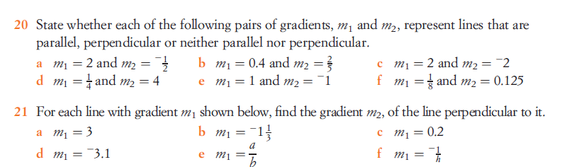
22. Show that the line joining (-2, 2) and (4, 8) is parallel to y = x + 10
23. Show that the line joining (-2, 5) and (4, -7) is parallel to 2x + y - 10 = 0

Slide 14
Example 1
Find the equation of the line which is perpendicular y=2x + 8 at the point (1,10)
Gradient will be -0.5
Equation so far is y=-0.5x + c
We know it passes through (1,10) so put these values in
10=-0.5+ c
c must be 10.5
y=-0.5x + 10.5

Slide 15
Example 2
Find the equation of the line which is perpendicular y=5x + 8 at the point (5,33)
Gradient will be -1/5
Equation so far is y=-1/5x + c
We know it passes through (5,33) so put these values in
33=-1+ c
c must be 34
y=-2x + 34

Slide 16
Example 3
Find the equation of the line which is perpendicular y=-1/3x + 8 at the point (9,5)
Gradient will be 3
Equation so far is y=3x + c
We know it passes through (9,5) so put these values in
5=27+ c
c must be -22
y=-3x -22

Slide 17
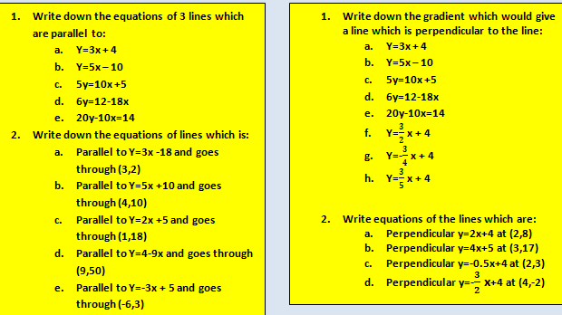
Parallel and Perpendicular lines
ANSWERS
any line with a gradient of 3
any line with a gradient of 5
any line with a gradient of 2
any line with a gradient of -3
any line with a gradient of 0.5
y=3x-7
y=5x-10
y=2x+16
y=131-9x
y=-3x-15
-1/3
-1/5
-0.5
1/3
-2
2/3
4/3
-5/3
y=-0.5x + 9
y= -0.25x + 17.75
y= 2x-1
y= -2/3x + 1/3

